Slide 1

Chapter Two
Accounting for Accruals and Deferrals
McGraw-Hill/Irwin
Copyright © 2013 by The McGraw-Hill Companies, Inc. All rights reserved
Notes:
In this chapter, we will learn more about the accounting cycle.

Slide 2
Cash Basis vs.
Accrual Accounting
Recognition
Realization
Formally recording an economic
item or event in the
financial statements
Collecting cash, generally from the sale of products or services
Notes:
Part I
Users of financial statements must distinguish between the terms recognition and realization. Recognition means formally recording an economic item or event in the financial statements. Realization refers to collecting cash, generally from the sale of products or services.
Part II
Users of cash basis accounting recognize revenues and expenses when cash is paid or collected. In contrast, users of accrual basis accounting recognize revenues when earned and expenses when incurred, regardless of when cash is exchanged. Virtually all of the major companies operating in the United States use accrual accounting.
Part III
Let’s demonstrate accrual accounting by describing events that relate to a company named Cato Consultants.

Slide 3
What is ACCRUAL ACCOUNTING?
Recording the financial transactions of a business in the period in which they occur (incurred), rather than in the period in which cash is exchanged.

Slide 4
Matching Concept
Cash basis accounting can distort the measurement of net income because it sometimes fails to properly match revenues with expenses.
The problem is that cash is not always received or paid in the period when the revenue is earned or when the expense is incurred.
The objective of accrual accounting is to improve matching of revenues with expenses.
Notes:
Part I
Accounting systems are designed to record most recurring daily transactions, particularly any involving cash.
The problem is that cash is not always received or paid in the period when the revenue is earned or when the expense is incurred. Cash basis accounting can distort reported net income because it sometimes fails to match expenses with the revenues they produce.
Part II
The solution for this timing difference is to record adjusting entries at the end of the period to get the amounts reported as revenues and expenses up to date. Expenses that are matched with the period in which they are incurred are frequently called period costs.
Let’s look at an example using the second year transactions for Conner Consultants.

Slide 5
Examples of Accrual Events
Sales made “on account”
Purchases made “on credit”
Wages expense for employees
    when they’ve worked but you haven’t yet paid them
Interest on money borrowed or lent
    when time has passed (so interest has been
    earned by the lender) but the actual cash
    for the interest has not changed hands
Income tax expense
    when you owe it but haven’t yet paid the IRS

Slide 6
Accounts Receivable--amounts owed by customers for goods and services received.
Recognition of event versus realization of cash
  recognizing an event means to record it in the accounting records
  the term is most often used with respect to recording revenues and expenses on the income statement
Accounts Rec.

Slide 7
Accounts Payable--amounts you owe creditors for the purchase of goods and services.
When are costs recognized as expenses?
  when the “matching” revenue is recognized, or
  when the benefits of the expenditures are received
INVOICE

Slide 8
What is a deferral?
A deferral event occurs when:
  cash is received before revenue is earned
or
- cash is paid before an expense is incurred.
Deferral events are a part of the accrual basis of accounting
Notes:
2

Slide 9
Deferred Expenses:
You’ve paid the cash “up-front” but you haven’t
received the goods or services yet.
Prepaid Expenses
Prepaid Rent
Prepaid Insurance
Supplies
Prepaid Expenses are ASSETS!
Asset Exchange:
Cash asset is decreased
Prepaid Expense asset is increased.
Notes:
4

Slide 10
Deferred Revenue
You’ve received payment for something you have NOT yet provided.
Revenue is not recognized until the service is performed or the goods are delivered...but you have to record the fact that you have received the cash, and….
A related LIABILITY (Unearned Revenue) must be recorded and kept on the books until you EARN the revenue.
Notes:
18

Slide 11
Accruals vs. Deferrals (Revenues)
Accrual event
Now Later
  Business action Cash exchange
Deferral event
Now Later
  Cash exchange Business action
Performed Services on account
Collect receivables later.
Collected Cash from customers, but services not yet performed.
Perform the services we have already been paid for.
Notes:
3

Slide 12
Accruals vs. Deferrals (Expenses)
Accrual event
Now Later
  Business action Cash exchange
Deferral event
Now Later
  Cash exchange Business action
Incurred expense on credit. (Haven’t paid yet.)
Use cash to pay for expense previously recorded.
Pay Cash now for something that will not be EXPENSED until later.
Record an EXPENSE when item purchased before is used up.
Notes:
3

Slide 13
Review of Core Concepts
Asset Source Transactions--an asset increases and a corresponding claims account increases
Asset Use Transactions--an asset decreases and a corresponding claims account decreases
Asset Exchange Transactions--one asset increases and another asset decreases
Claims Exchange Transactions--one claims account increases and another decreases

Slide 14
Cato Consultants began 2013 with the following account balances:
Event 1: Cato Consultants acquired $70,000 cash by issuing common stock.
Asset Source Transaction
Notes:
Part I
Cato Consultants began the 2013 accounting period with the following account balances; Cash, fifteen thousand dollars; Supplies, two hundred dollars, Common Stock, ten thousand dollars, and Retained Earnings, five thousand, two hundred dollars.
Part II
Event 1: Cato Consultants acquired seventy thousand dollars cash by issuing common stock.
Part III
Here is the effect of this transaction on the financial statements model. Both cash, an asset, and stockholders’ equity increase by seventy thousand dollars.
Part IV
This is considered to be an asset source transaction.

Slide 15
Event 2: During 2013, Cato Consultants provided $180,400 of consulting services to its clients but no cash has been collected.
Increase assets (accounts receivable).
Increase stockholders’ equity (retained earnings).
Asset Source Transaction
Notes:
Part I
Event two: During 2013, Cato Consultants provided one hundred eighty thousand four hundred dollars of consulting services to its clients but no cash has been collected.
This type of transaction is frequently referred to as providing services on account.
Part II
This transaction increases the accounts receivable asset account and, because of revenue, increases the retained earnings stockholders’ equity account. It is classified as an asset source transaction.
Accrual accounting requires companies to recognize revenue in the period in which the work is done regardless of when cash is collected.
Part III
Here is the effect of this transaction on the financial statements model. Notice that the event affects the balance sheet and the income statement but not the statement of cash flows since cash was not collected as part of this transaction.

Slide 16
Event 3: Cato collected $165,000 cash from customers in partial settlement of its accounts receivable.
Increase assets (cash).
Decrease assets (accounts receivable).
Asset Exchange Transaction
Notes:
Part I
Event three: Cato collected one hundred sixty five thousand dollars cash from customers in partial settlement of its accounts receivable.
Part II
This transaction increases the cash asset account and decreases the accounts receivable asset account. The income statement is not affected, but the statement of cash flows reports an inflow for operating activities. It is classified as an asset exchange transaction.
Part III
Here is the effect of this transaction on the financial statements model. Notice that the event affects the statement of cash flows since cash was collected as part of this transaction.

Slide 17
Event 4: Cato paid the instructors $42,000 cash in 2013 to teach the training courses in 2013.
Decrease cash (assets).
Decrease stockholders’ equity (retained earnings).
Asset Use Transaction
Notes:
Part I
Event four: Cato paid the instructors forty two thousand dollars to teach the training courses.
Part II
This transaction decreases the cash asset account and decreases the retained earnings stockholders’ equity account. The salaries expense reduces net income, and the statement of cash flows reports an outflow for operating activities. This is classified as an asset use transaction.
Even in accrual accounting, sometimes expenses are recognized at the time that cash is paid, as long as it is the same time that the expense is incurred.
Part III
Here is the effect of this transaction on the financial statements model.

Slide 18
Event 5: Cato paid $22,000 for advertising costs. The advertisements appeared in 2013.
Decrease assets (cash).
Decrease stockholders’ equity (retained earnings).
Asset Use Transaction
Notes:
Part I
Event five: Cato paid twenty two thousand dollars for advertising costs. The advertisements appeared in 2013.
Part II
This transaction decreases the cash asset account and decreases the retained earnings stockholders’ equity account. The advertising expense will decrease net income. The statement of cash flows reports an outflow for operating activities. This is also classified as an asset use transaction.
Part III
Here is the effect of this transaction on the financial statements model.

Slide 19
Event 6: Cato signed a one-year lease agreement and paid $12,000 in advance for the lease, which begins on March 1.
Decrease assets (cash).
Increase assets (prepaid rent).
Asset Exchange Transaction
Notes:
Part I
Event six. Cato signed a one-year lease agreement and paid twelve thousand dollars cash in advance for the lease. The lease begins on March first.
Part II
This transaction decreases the cash asset account, but increases another asset, prepaid rent. Therefore, it is classified as an asset exchange transaction. The prepaid rent is recorded as an asset, but will become an expense later when it is used. The income statement is not affected, but the statement of cash flows will report an outflow for operating activities.
Part III
Here is the effect of this transaction on the financial statements model.

Slide 20
Event 7: Cato received $18,000 cash in advance from Westberry Company for consulting services to be performed over a one-year period beginning on June 1.
Increase assets (cash).
Increase liabilities (unearned revenue).
Asset Source Transaction
Notes:
Part I
Event seven. Cato received eighteen thousand dollars cash in advance from Westberry Company for consulting services Cato agreed to perform over a one-year period beginning June first.
Part II
This transaction increases the cash asset account, and increases a liability account called unearned revenue. Cato must defer, or delay, any revenue until it performs the consulting services for Westberry Company, so the income statement is not affected. The deferred, or unearned, revenue is a liability for Cato because it is obligated to perform the services in the future. The statement of cash flows reports an inflow for operating activities. This is classified as an asset source transaction.
Part III
Here is the effect of this transaction on the financial statements model.

Slide 21
Event 8: Cato paid $800 cash to purchase supplies.
Decrease assets (cash).
Increase assets (supplies).
Asset Exchange Transaction
Notes:
Part I
Event eight. Cato paid eight hundred dollars to purchase supplies.
Part II
This transaction decreases the cash asset account, but increases supplies, an asset. It is also classified as an asset exchange transaction. Like prepaid rent, supplies is an asset account, which will be recognized as an expense when the supplies are used. The income statement is not affected. The statement of cash flows reports an outflow for operating activities.
Part III
Here is the effect of this transaction on the financial statements model.

Slide 22
Event 9: Cato incurred $86,000 of other operating expenses on account.
Increase liabilities (accounts payable).
Decrease stockholders’ equity (retained earnings).
Claims Exchange Transaction
Notes:
Part I
Event nine. Cato incurred eighty six thousand dollars of other operating expenses on account.
Part II
This transaction increases one claims account, accounts payable, a liability account. It also decreases another claims account, retained earnings, an equity account. The expense decreases net income. It does not affect the statement of cash flows. It is classified as a claims exchange transaction.
Part III
Here is the effect of this transaction on the financial statements model.

Slide 23
Event 10: Cato paid $60,200 cash in partial settlement of accounts payable.
Decrease assets (cash).
Decrease liabilities (accounts payable).
Asset Use Transaction
Notes:
Part I
Event ten. Cato paid sixty thousand two hundred dollars cash in partial settlement of accounts payable.
Part II
This transaction decreases the cash asset account and decreases the accounts payable liability account. The income statement is not affected. The statement of cash flows reports an outflow for operating activities. It is classified as an asset use transaction.
Part III
Here is the effect of this transaction on the financial statements model.

Slide 24
Event 11: Cato paid $100,000 for land it planned to use in the future to build a home office.
Decrease assets (cash).
Increase assets (land).
Asset Exchange Transaction
Notes:
Part I
Event eleven. Cato paid one hundred thousand dollars cash for land it planned to used in the future to build a home office.
Part II
Purchasing land with cash is an asset exchange transaction. The income statement is not affected. It is classified as an investing activities on the statement of cash flows.
Part III
Here is the effect of this transaction on the financial statements model.

Slide 25
Event 12: Cato paid $21,000 in cash dividends to its stockholders.
Decrease assets (cash).
Decrease stockholders’ equity (retained earnings).
Asset Use Transaction
Notes:
Part I
Event twelve. Cato paid twenty one thousand dollars in cash dividends to its stockholders.
Part II
The payment of dividends decreases the cash asset account and decreases the retained earnings equity account. However, it does not affect the income statement because dividends are not expenses. Like any exchange of cash between the company and its owners, it is classified as a financing activity on the statement of cash flows.
Part III
Here is the effect of this transaction on the financial statements model.

Slide 26
Event 13: Cato signed contracts for $27,000 of consulting services to be performed in 2014.
Notes:
Part I
Event thirteen: Cato signed contracts for twenty seven thousand dollars of consulting services to be performed in 2014.
Part II
Because this event is just the signing of a contract, it does not affect any of the financial statement model.
The $27,000 for consulting services to be performed in 2014 is not recognized in the 2013 financial statements. Revenue is recognized for work actually completed, not work expected to be completed. This event does not affect any of the financial statements.

Slide 27
Adjust Ending Balances
Make year-end adjustments to recognize accrued and deferred revenues and expenses.

Slide 28
Adjustment 1: As of December 31, 2013, Cato had earned $500 of accrued interest revenue.
Increase assets (interest receivable).
Increase stockholders’ equity (retained earnings).
Asset Source Transaction
Notes:
Part I
Adjustment one. As of December 31, 2013, Cato had earned five hundred dollars of accrued interest revenue.
Part II
Because interest is earned continuously, it is impractical to recognize it as it occurs. Instead, companies commonly record interest revenue and interest expense as a year-end adjustment. Cato expects to collect, or realize, the interest sometime in 2014. Note that year-end adjustments never affect the cash account. Accruing interest receivable is an asset source transaction.
Part III
Here is the effect of this transaction on the financial statements model.

Slide 29
Adjustment 2: As of December 31, 2013, Cato had earned $10,500 of the $18,000 it collected in advance on June 1.
Decrease liabilities (unearned revenue).
Increase stockholders’ equity (retained earnings).
Claims Exchange Transaction
Notes:
Part I
Adjustment two. As of December 31, 2013, Cato had earned ten thousand five hundred dollars of the eighteen thousand dollars it collected in advance on June first.
Part II
Recall that in event seven, Cato collected eighteen thousand dollars cash in advance from Westberry Company and agreed to perform consulting services over a one-year period between June 1, 2013 and May 31, 2014. As of December 31, seven of the twelve months have passes, so Cato can recognize revenue for seven twelfths of the eighteen thousand dollars, or ten thousand five hundred dollars. Because a liability account decreases and an equity account increases, it is classified as a claims exchange transaction. Like all other year-end adjustments, it does not affect the statement of cash flows.
Part III
Here is the effect of this transaction on the financial statements model.

Slide 30
Adjustment 3: As of December 31, 2013, Cato had $10,000 of accrued salary expense that will be paid in 2014.
Increase liabilities (salaries payable).
Decrease stockholders’ equity (retained earnings).
Claims Exchange Transaction
Notes:
Part I
Adjustment three. As of December 31, 2013, Cato had ten thousand dollars of accrued salary expense that will be paid in 2014. Cato records accrued salary expense of $10,000 (the salary expense is for courses the instructor taught in 2013 that Cato will pay cash for in 2014).
Part II
Accrual accounting requires companies to recognize expenses when they are incurred, regardless of when they are paid. Cato must recognize salary expense in 2013, the year that the instructors perform the work, even though the payment will not be made until 2014. The adjusting entry affects the balance sheet by increasing the salaries payable liability account and decreasing the retained earnings equity account. It is a claims exchange transaction. Total claims remain unchanged. The salary expense is reported on the income statement and will decrease net income.
Part III
Here is the effect of this transaction on the financial statements model.

Slide 31
Adjustment 4: As of December 31, 2013, Cato had used $10,000 of the $12,000 of rent that was prepaid on March 1.
Decrease assets (prepaid rent).
Decrease stockholders’ equity (retained earnings).
Asset Use Transaction
Notes:
Part I
Adjustment four. As of December 31, 2013, Cato had used ten thousand dollars of the twelve thousand dollars of rent that was prepaid on March first.
Part II
Recall that in event two, Cato had paid twelve thousand dollars in advance for twelve months of rent. Between March first and December thirty-first, Cato has used ten of the twelve months’ rent. Therefore, Cato must recognize ten thousand dollars of rent expense, and reduce the prepaid rent asset. It is classified as an asset use transaction.
Part III
Here is the effect of this transaction on the financial statements model.

Slide 32
Adjustment 5: As of December 31, 2013, a physical count of the supplies on hand revealed that $150 of supplies remained available for future use.
Decrease assets (supplies).
Decrease stockholders’ equity (retained earnings).
Asset Use Transaction
Beginning supplies balance $200 | + | Supplies purchased $800 | = | Supplies available for use $1,000 | - | Ending supplies balance $150 | = | Supplies used $850
Notes:
Part I
Adjustment five. As of December 31, 2013, a physical count of the supplies on hand revealed that $150 of supplies remained available for future use.
Part II
Companies would find it impractical to record expense each time an individual supply is used. Instead, they record supplies expense at the end of the year by determining the total quantity of supplies used.
Part III
To calculate the quantity of supplies used, add together the beginning supplies balance and supplies purchased to determine supplies available for use. Then, subtract the ending supplies balance to determine supplies used. Cato used eight hundred and fifty dollars of supplies during the year; therefore, that is the supplies expense that they will record. This is an asset use transaction.
Part IV
Here is the effect of this transaction on the financial statements model.

Slide 33
LO 3
Organize general ledger accounts under an accounting equation.

Slide 34
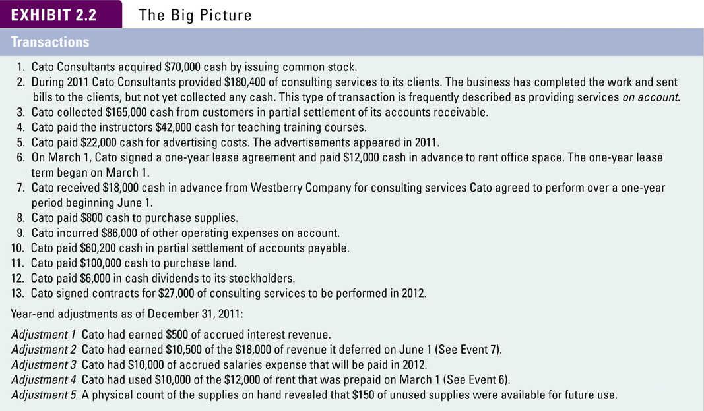
Summary of Transactions
Notes:
Part I
Here is a summary of the transactions we just looked at for Cato Consultants. Take a few minutes and make sure you understand each transaction’s impact on the financial statements model.
Part II
Now, let’s prepare the financial statements for Cato Consultants using the data presented above.

Slide 35
LO 4
Prepare financial statements based on accrual accounting.

Slide 36
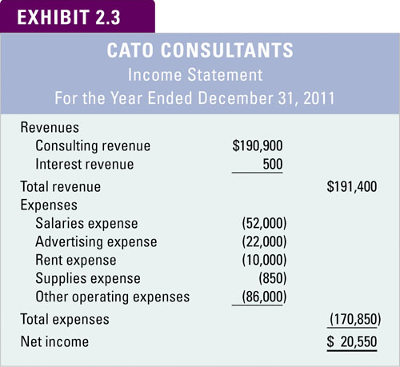
Preparing Financial Statements
Notes:
Here is the income statement and statement of stockholders’ equity for Cato Consultants. Recall that revenue represents the benefit Cato experiences from operating its business. In accounting terms, revenue can be defined as increases in assets or decreases in liabilities from providing goods or services to customers in the normal course of operations. Expenses are the sacrifices that must be made to earn revenues. In accounting terms, expenses can be defined as decreases in assets or increases in liabilities resulting from consuming assets and services to generate revenue.

Slide 37
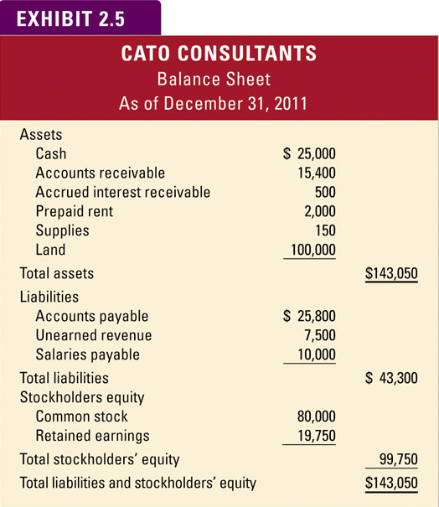
Preparing Financial Statements
10,000
$128,050
4,750
$128,050
Notes:
Here is the balance sheet for Cato Consultants. It discloses the entity’s assets, liabilities, and stockholders’ equity at a particular point in time. At this particular point in time, Cato has one hundred forty three thousand fifty dollars in assets. Assets are listed on the balance sheet in order of liquidity; that is, how rapidly they are expected to turn into cash. The lower half of the balance sheet describes the parties who have a claim or ownership interest in the company’s assets.

Slide 38
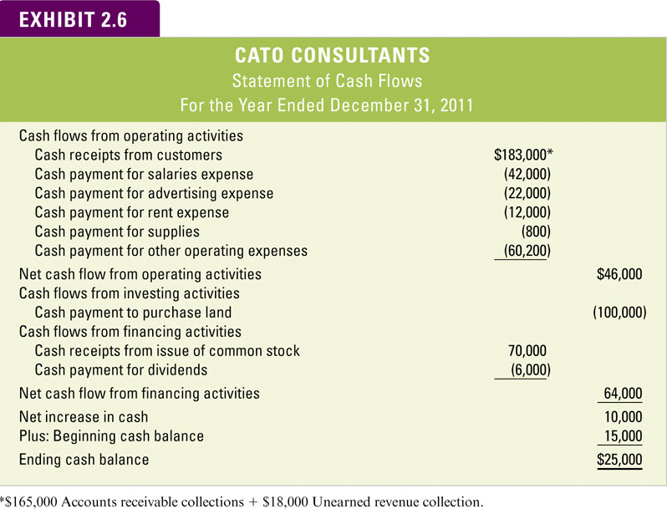
Preparing Financial Statements
(21,000)
49,000
(5,000)
10,000
Notes:
Here is Cato Consultants’ statement of cash flows. It explains the change in cash from the beginning of the accounting period to the end of the accounting period. It can be prepared by analyzing the increases and decreases in the cash account.
Notice that the amount of cash flows from operations of forty six thousand dollars is different from the twenty thousand five hundred fifty dollars in net income reported on the income statement we saw earlier. The difference results from the fact that the cash consequences associated with revenues and expenses recognized in 2013 will not be fully realized until 2014 . Avoid the misconception of many students in their first accounting class who confuse revenue and expenses as equivalent with cash.

Slide 39
LO 5
Describe the closing process, the accounting cycle, the matching concept, and the conservatism principle.

Slide 40
Review: The Closing Process
Transfers net income (or loss) and dividends to Retained Earnings.
Establishes zero balances in all revenue, expense, and dividend accounts.
Notes:
At the end of the year, closing journal entries are prepared. Closing entries serve two purposes. First, they transfer net income (or loss) and dividends to Retained Earnings. This process gets the Retained Earnings account balance up to date. Second, they establish zero balances in all income statement and dividend accounts so they are ready to start collecting amounts for the next accounting period.

Slide 41
Temporary and Permanent Accounts
Revenues
Assets
TemporaryAccounts
Permanent Accounts
Equity
Liabilities
Expenses
Dividends
Temporary accounts track financial results for a limited period of time.
Permanent accounts track financial results from year to year.
Notes:
Part I
Accounts that are closed (revenues, expenses, and dividends) are referred to as temporary accounts. Temporary accounts track financial results for a limited period of time.
Part II
Balance sheet accounts (assets, liabilities, and equity) are referred to a permanent accounts, and they are not closed. The amounts in these accounts will carry forward into the next accounting period.

Slide 42
Matching Concept
Cash basis accounting can distort the measurement of net income because it sometimes fails to properly match revenues with expenses.
The problem is that cash is not always received or paid in the period when the revenue is earned or when the expense is incurred.
The objective of accrual accounting is to improve matching of revenues with expenses.
Notes:
Part I
Accounting systems are designed to record most recurring daily transactions, particularly any involving cash.
The problem is that cash is not always received or paid in the period when the revenue is earned or when the expense is incurred. Cash basis accounting can distort reported net income because it sometimes fails to match expenses with the revenues they produce.
Part II
The solution for this timing difference is to record adjusting entries at the end of the period to get the amounts reported as revenues and expenses up to date.
Let’s look at an example using the second year transactions for Conner Consultants.

Slide 43
Steps in an Accounting Cycle
Record Transactions
Close Nominal Accounts
Adjust Accounts
Prepare Statements
Notes:
Part I
Let’s review the steps in the accounting cycle. First, we record transactions during the accounting period.
Part II
At the end of the accounting period, we make any necessary adjusting entries to get the account balances up to date.
Part III
Next, we prepare financial statements for the accounting period.
Part IV
Next, we close the nominal or temporary accounts.

Slide 44
The Conservatism Principle
When faced with a recognition dilemma, conservatism guides accountants to select the alternative that produces the lowest amount of net income.
Notes:
When faced with a recognition dilemma, conservatism guides accountants to select the alternative that produces the lowest amount of net income. The conservatism principle holds that it is better to understate earnings than to overstate them.

Slide 45
LO 6
Classify accounting events into one of four categories.

Slide 46
Recap: Types of Transactions
The described transactions can be classified into one of four categories:
Asset
source
Asset
use
Asset
exchange
Claims
exchange
Increase assets, increase claims on assets
Decrease assets, decrease claims on assets
Increase one asset, decrease another asset
Increase one claims account, decrease another.
Notes:
Although businesses engage in an infinite number of different transactions, all transactions fall into one of four types, which include:
Asset source transactions.
Asset use transactions.
Asset exchange transactions.
Claims exchange transactions.

Slide 47
LO 7
Discuss the primary components of corporate governance.

Slide 48
Corporate Governance
Corporate governance is the set of relationships between the board of directors, management, shareholders, auditors, and other stakeholders that determines how a company is operated.
Notes:
Corporate governance is the set of relationships between the board of directors, management, shareholders, auditors, and other stakeholders that determines how a company is operated. Following are key components of corporate governance.

Slide 49
Importance of Ethics
The accountant’s role requires trust and credibility.
Accounting information is worthless if the accountant is not trustworthy.
Therefore, the accounting profession requires high ethical standards.
Notes:
The accountant’s role in society requires trust and credibility. Accounting information is worthless if the accountant is not trustworthy.

Slide 50
AICPA Code of Professional Conduct
Includes articles requiring CPAs to
Exercise sensitive professional and moral judgments.
Act in a way to serve the public interest.
Perform with the highest sense of integrity.
Be objective and independent, in fact and appearance.
Exercise due care.
Notes:
Therefore, the American Institute of Certified Public Accountants requires its members to comply with the Code of Professional Conduct. The importance of ethical behavior is recognized across a broad range of professional accounting organizations.

Slide 51
Sarbanes-Oxley Act
Prompted by the audit failures of Enron, WorldCom, and others
Key provisions:
  Created the Public Company Accounting Oversight Board (PCAOB)
  Requires management to certify financial statements
  Imposes harsh penalties on management for violations
Notes:
The audit failures at Enron, WorldCom, and others prompted Congress to pass the Sarbanes-Oxley Act (SOX).
The key provisions of SOX include:
The creation of the Public Company Accounting Oversight Board (PCAOB). The Board regulates accounting professionals that audit the financial statements of public companies.
Require a company’s chief executive officer (CEO) and chief financial officer (CFO) to certify in writing that they have reviewed the financial reports being issued and that the reports present fairly the company’s financial status.
Impose fines of up to $5 million and imprisonment of up to 20 years for CEOs and CFOs who falsely certify a company’s financial reports.

Slide 52
The Fraud Triangle
Opportunity
Key to protecting yourself and your company: personal integrity.
Pressure
Rationalization
Notes:
Unfortunately, it takes more than a code of conduct to stop fraud. People frequently engage in activities that they know are unethical or even criminal. The auditing profession has identified three elements that are typically present when fraud occurs, including:
The availability of an opportunity.
The existence of some form of pressure leading to an incentive.
The capacity to rationalize.
These three interrelated elements are frequently called the fraud triangle.

Slide 53

Analysis of Financial Statements Using Ratios
Bob Company’s Net Income is $4,000.
Is this good or bad?
If Bob only invested $1 to start the business, a $4,000 profit sounds great.
If he expected a $10,000 profit, he’s not happy.
If his competitor only earned $2,000 with a similar investment, Bob’s doing OK.

Slide 54

Analysis of Financial Statements Using Ratios
For a meaningful analysis we need:
1. a way to compare different size companies
Use financial RATIOS.
2. A basis of comparison.
a. Our past: (Are we getting better?)
b. Our budget: (Did we meet expectations?)
c. Our competitors: Who is better? Why?

Slide 55
Return on Assets Ratio
Evaluating performance requires considering the size of the investment base used to produce the income.
Net Income
Total Assets
This ratio measures the relationship between the level of income and the size of the investment. A larger ratio means the company did a better job of managing its assets.
Notes:
Evaluating performance requires considering the size of the investment base used to produce the income.
The return on assets ratio is calculated as net income divided by total assets. This ratio measures the relationship between the level of income and the size of the investment. A larger ratio means the company did a better job of managing its assets.

Slide 56
Debt to Assets Ratio
Borrowing money is risky business. This ratio helps evaluate the level of debt risk.
Total Debt
Total Assets
A smaller ratio indicates that there is less debt risk for the company.
Notes:
Borrowing money is risky business. The debt to assets ratio helps evaluate the level of debt risk.
It is calculated as total debt divided by total assets.
A smaller ratio indicates that there is less debt risk for the company.

Slide 57
Return on Equity Ratio
Owners are interested in this ratio to determine their return on their investment in the company.
Net Income
Stockholders’ Equity
A larger ratio indicates that the owners have a higher return on their investment.
Notes:
Owners are interested in this ratio to determine their return on their investment in the company.
Return on equity is calculated as net income divided by stockholders’ equity.
A larger ratio indicates that the owners have a higher return on their investment.

Slide 58
Analysis of Financial Statements Using Ratios (Data from Bob Co.)
Return on assets
  Net income $ %
  Total assets $
Debt to assets
  Total debt (Liabilities) $ %
  Total assets $
Return on equity Net income $ %
  Stockholders’ Equity $
=
=
=
=
=
=

Slide 59
Analysis of Financial Statements Using Ratios (Data from Bob Co.)
Return on assets
  Net income $ 4,000 21.1%
  Total assets $19,000
Debt to assets
  Total debt (Liabilities) $ 6,000 31.6%
  Total assets $19,000
Return on equity Net income $ 4,000 30.8%
  Stockholders’ Equity $13,000
=
=
=
=
=
=

Slide 60
Stockholders vs. Creditors
Stockholders like a lot of debt if the company can take advantage of positive financial leverage.
Creditors prefer less debt and more equity because equity represents a buffer of protection.
Notes:
Part I
Stockholders like a lot of debt if the company can take advantage of positive financial leverage.
Part II
Creditors prefer less debt and more equity because equity represents a buffer of protection.

Slide 61

Using Financial “Leverage”
Using borrowed money to increase the return on the Owners’ (the Stockholders’) Investment.
Ex: Borrow money at 10% to buy equipment. Earn 12% investment return on operating the equipment.
Net 2% increase to owners.

Slide 62
End of Chapter Two
Notes:
In this chapter, we learned more about accrual basis accounting and the accounting cycle. We also learned about corporate governance and the fundamentals of ethical accounting practices.

